Slide 1

AZURE ML PLATFORM
& FEATURE TOOLS

Slide 2

AZURE MODEL RESULTS
Logistic Regression
Decision Jungle
Boosted Decision Tree
Performance
Test AUC: 90.3%
Performance
Test AUC: 63%
Performance
Test AUC: 89.7%
Speed
Feature Engineering: NA
Feature Selection: NA
Model Parameter Tuning: NA
Model Training: 2 Mins
Speed
Feature Engineering: NA
Feature Selection: NA
Model Parameter Tuning: NA
Model Training: 2 Mins
Speed
Feature Engineering: NA
Feature Selection: NA
Model Parameter Tuning: NA
Model Training: 2 Mins
Interpretability
Features/Models: Below Average
Interpretability
Features/Models: Below Average
Interpretability
Features/Models: Below Average

Slide 3
SIGNIFICANT VARIABLES
address; Segmentation (tariff-details); CustomerType:B2B, B2S, B2C, B2G; Delivery: Overnight/Standard; New/Existing Customer; PriceLine; Risk-Index Hardware;
Time of order; weekday of order;SubPriceLine des Produkts; orderdetails.ProduktID:;
orderdetails.ProduktID;
number of ordered hardware articles; numberSlaving;
Shop-ID
ProviderTo: E1(E-Plus)/D2(VF),
Total number of features ICD (external credit agency)
SubPriceLine: ( Tariff)
Logistic Regression
Application score
8th digit of IBAN (Banking group) with special missing for non-German banks
Number of days since first customer registration
Flag: delivery address unequal to billing address
Risk-Index Hardware (definition of Telco provider)
Part of the application score (Kundenscore)
contract number
Boosted Decision Tree
Boosted Decision Jungle

Slide 4
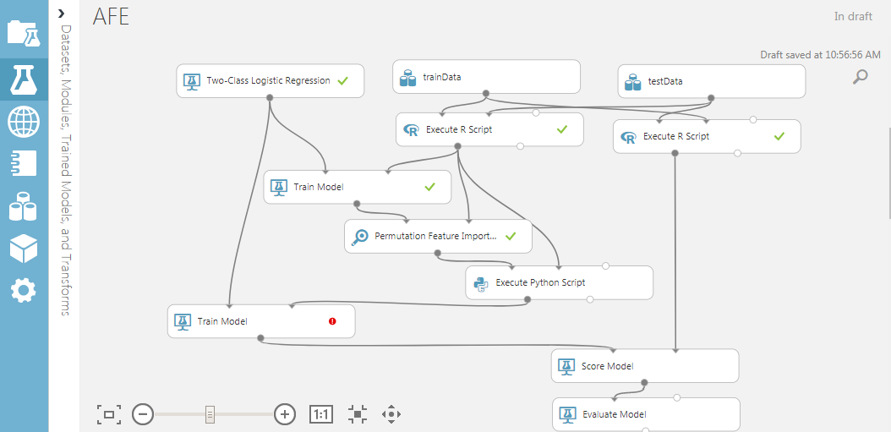



Modelling in Azure
To use only Significant variables by a pre-defined selection method using permutation feature selection
To use Feature Labs python package to do feature transformation
To use more R functionality like XG boost to improve the AUC and accuracy

Slide 5

Featuretools Overview
Featuretools is a Python based package to perform automated feature engineering :
Deep Feature Synthesis : A minimal input to DFS is a set of entities, a list of relationships, and the “target_entity” to calculate features for. The output of DFS is a feature matrix and the corresponding list of feature defintions.
Feature primitives are the building blocks of Featuretools:
They define individual computations that can be applied to raw datasets to create new features
They can be applied across datasets and can stack to create new calculations

Slide 6
Featuretools Transformations
Two types of Primitive Transformations are used: Transform and Aggregation
Transform – Creates a new variable from an existing variable
Aggregation – Computes a single value based on multiple instances of a variable
Datetime Transform Primitives
Hour, Minute, Second
Cumulative Transform Primitives
CumCount
Text Transform Primitives
NumCharacters
Weekday, Weekend (Boolean indicating if weekday/weekend)
Day, Week, Month, Year
CumSum
CumMean
TimeSincePrevious
NumWords
Aggregation Primitives
Count
Sum
Mean
Std
Median
Mode
TimeSinceLast
Skew
Trend
AvgTimeBetween

Slide 7
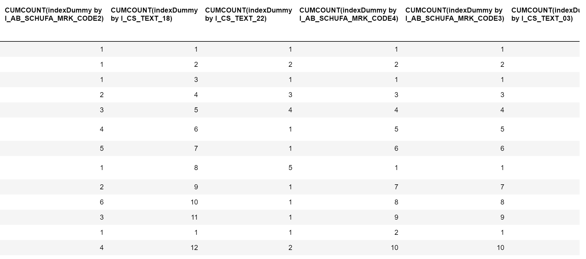
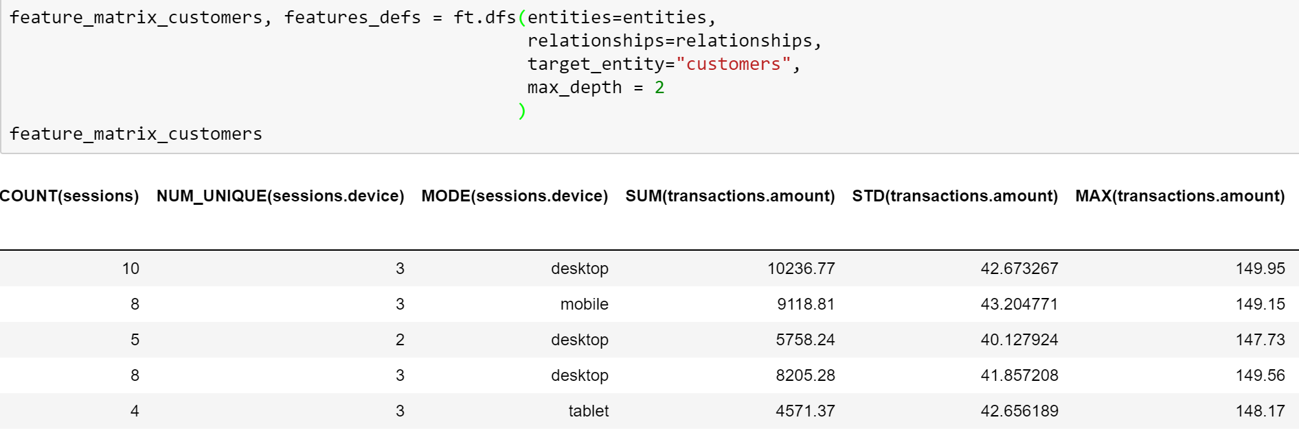
Feature Generation Examples
Arvato Dataset
Mock Dataset

